Slide 1
Project Presentation
“IOT Network Based on Zephyr”
By | Course(s)
Anas Shahzad | 1DT103 and 1DT108
Murali Tejeshwar Janaswami | 1DT103 and 1DT108
Jonathan Bjarnason | 1DT108

Slide 2
First, the PES project!

Slide 3
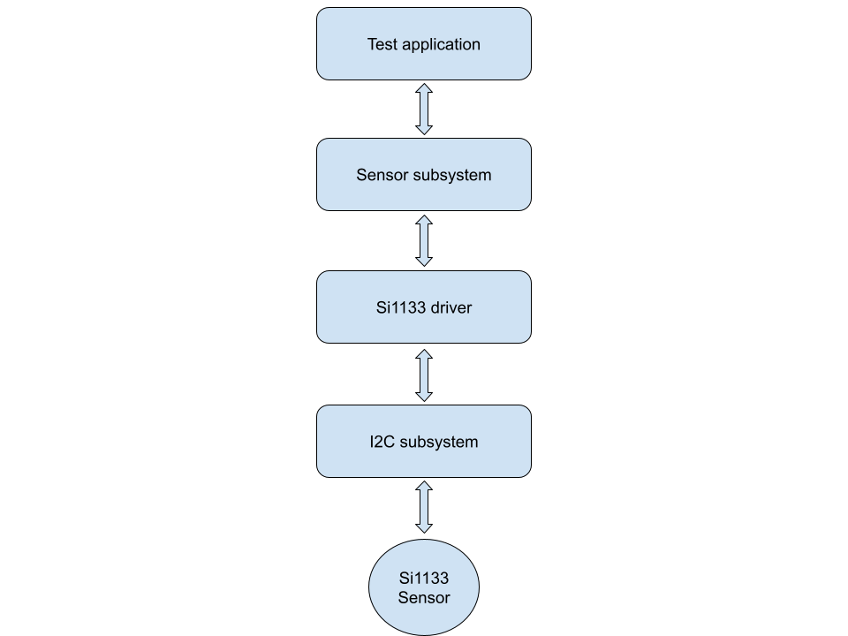
Overall Description of The Project
Si1133 Zephyr driver
Measures ambient, ultraviolet, and infrared light
Two configuration options: indoor(default) and outdoor ambience
Driver uses forced mode for initiating measurements
Driver interacts with sensor through i2c subsystem
Driver reports measurements to sensor subsystem
Application retrieves measurements from sensor subsystem
Notes:
PES Programming Embedded Systems

Slide 4
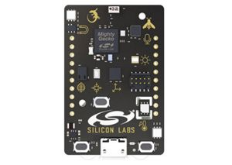
Live Demo
Using Thunderboard-2 (with Si1133)
Test application that displays measurements
Periodically (every two seconds)
Using serial console (minicom)

Slide 5
Technical Challenges and Highlights
Challenges
Enabling proper power supply to the sensor
The driver needs to enable sensor power on a specific GPIO port
Creating a Device Tree Binding YAML file
zephyr/dts/bindings/sensor/silabs,si1133.yaml
Highlights
Gained insights on the following
How operating system drivers work
How to interpret device datasheet
How to interact with various subsystems (I2C, sensor, GPIO; etc)

Slide 6
Original Plan vs Final Outcome
Accomplished everything that was originally planned
Driver
Test application
Git repo for the project
Team work
* Currently in the process of submitting the driver patch to Zephyr

Slide 7
Next up, the WCNES project!

Slide 8
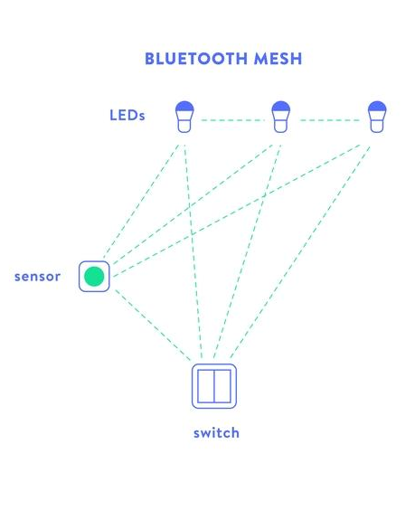
Overall Description of The Project
Understanding Bluetooth Mesh model
Setup Bluetooth Mesh network using Zephyr BLE stack
Using a client device to control a set of server devices
Individual and group addressing of server devices
Extend the range of network through “relay” feature
Log down relevant messages on the serial console
Ex: switch ON/OFF light

Slide 9
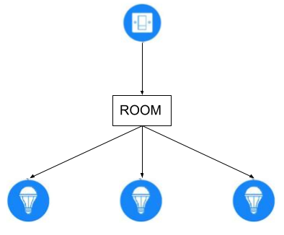
Architecture of The Implementation
Switch
nRF52840_DK boards being used as client and servers
Buttons on the DK generate control signals to operate LEDs on the servers
A smartphone serves as a provisioner
Group addressing of server nodes for simplicity
Lights

Slide 10
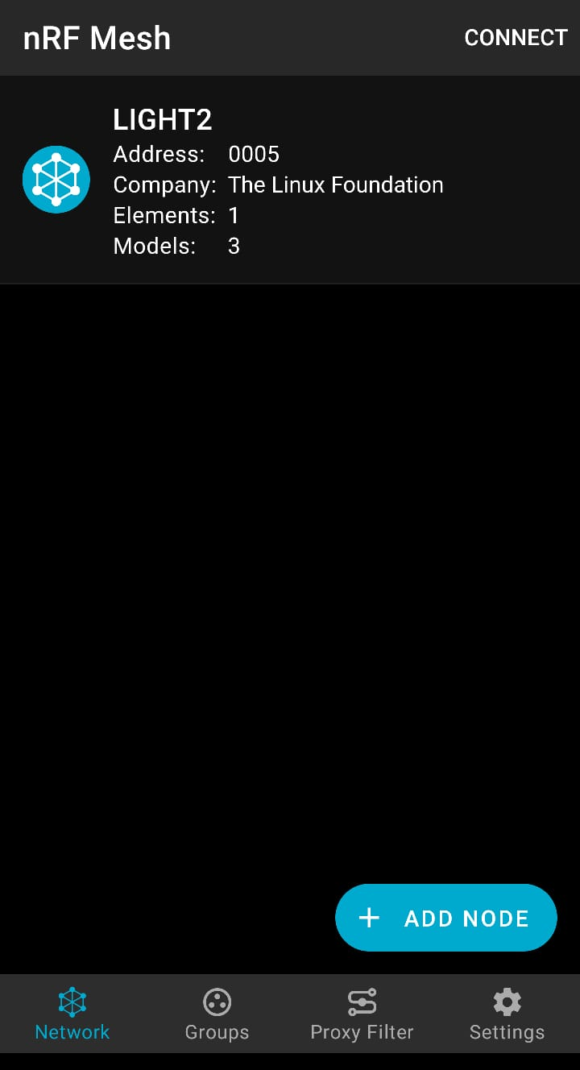
Provisioning and Configuration
Adding a device to the network
Providing a network key
Configuring the nodes
Application key
Destination address
Subscription to a group
TTL
Encryption

Slide 11
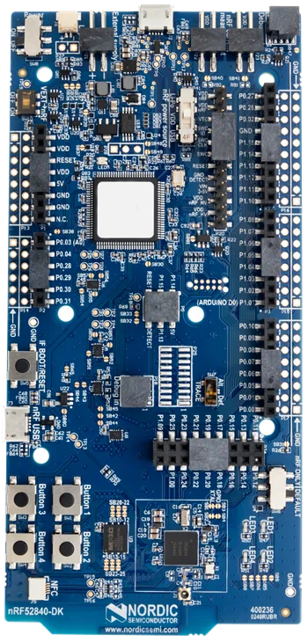
Demo
nRF52840_DK boards being used as client and servers
Boards #1 and #2 being used as server nodes
Emulating a real-world light
Board #3 being used as a client node
Emulating a real-world switch
Pressing button 1 on board #3 toggles LED 1 on boards #1 and #2
Screenshots attached in the following slides
Pressing button 2 on board #3 gets the status of all the servers
Outputs the same on the serial console (PuTTY)

Slide 12
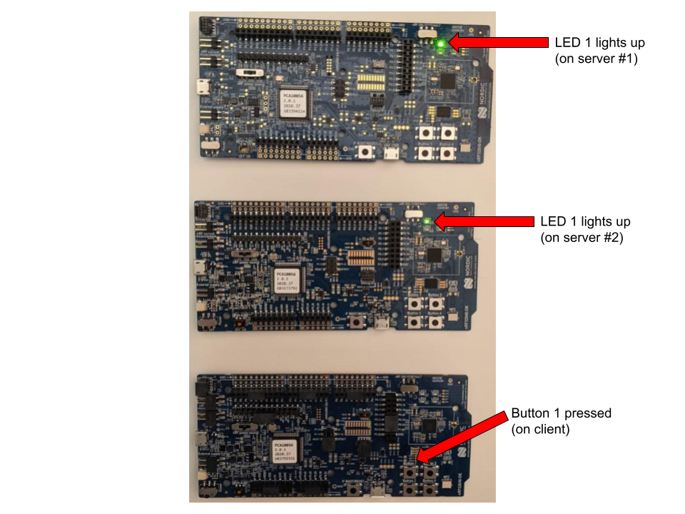

Slide 13
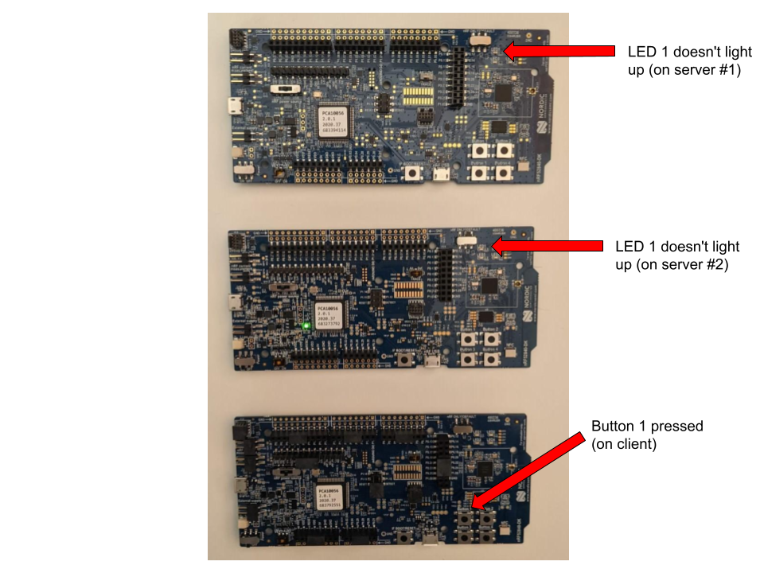

Slide 14
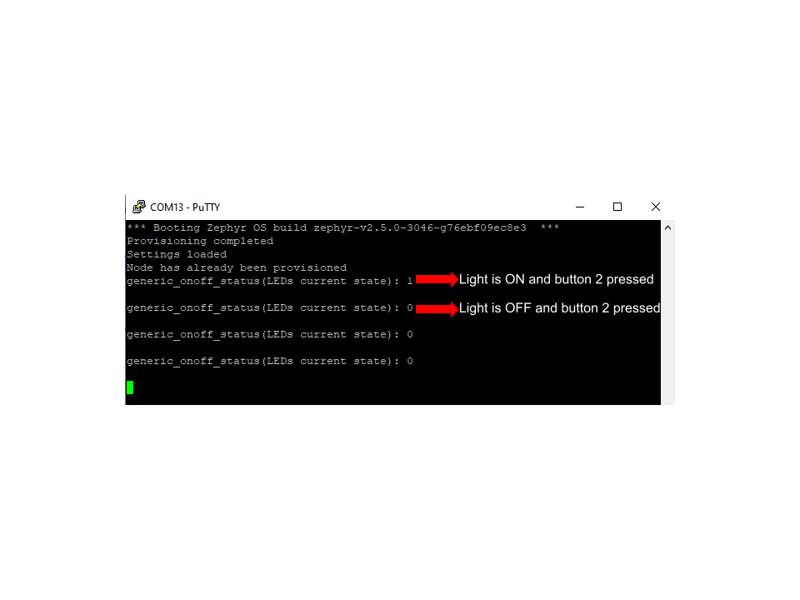

Slide 15
Technical Challenges and Highlights
Challenges
Zephyr BT Mesh is not well documented
Required a lot of time to understand the BT Mesh profile
Configuring and provisioning a device into the mesh network
Is a complicated process
Issue with Zephyr shell utility (currently missing critical provisioning commands)
Used nRF Mesh smartphone application for handling provisioning
Highlights
Gained insights on the following
BT Mesh profile and specifications, Zephyr BT Mesh APIs, provisioning process, authentication and encryption

Slide 16
Original Plan vs Final Outcome
Using Thunderboard-2 as a server
Silicon Lab’s proprietary radio interface had no support in Zephyr
SI’s Simplicity Studio was not well documented and lacked support for Thunderboard-2
Writing a custom provisioner or using Zephyr’s BT Mesh shell utility
Provisioning worked, configuration didn’t
Zephyr’s Mesh shell utility was missing critical commands
The documentation explicitly mentions them
Notes:
Overall description of the system
Most of you must be aware of BT Mesh functionality.
Our plan was to implement a BT mesh network using zephyr supported libraries (we just kinda liked zephyr and nordic devices) to understand how a Mesh Network works and how zephyr works.
So the idea was to design a mesh network which has a light/temperature sensor as a base station that controls a set of devices by sending control signals and is aware of the status of all the devices in the network and their status.
Bluetooth mesh is a networking stack not a radio technology. The Bluetooth mesh stack sits on top of Bluetooth LE. Bluetooth LE provides the underlying radio communications capability used by Bluetooth mesh.
The mesh network can be expanded to thousands of devices as part of a network and they can talk to each other individually by a uni-cast address or to a group of devices through a group address.
Communication between nodes can take place substantially beyond the direct range of the underlying Bluetooth radio because messages may hop from node to node through a process known as relaying until they reach their eventual destination.
With the right kind of control signals, this network can be used to in IOT systems like smart homes.
Architecture of the system
NrfDK as basestation and Clients.
Buttons on DK generate control signals to control LEDs on the Clients.
A second button fetches the status of the devices.
A a mobile phone as a provisioner & configurer.
For the sake of simplicity, the current implementation has the the clients configured with a group address so all the devices perform the same function on button presses.
The mobile application comes from nrf and is used to provision and configure the devices in the newtwork.
Provisioning and Configuration
for a device to have the ability and the right to communicate in a particular mesh network, it must first go through a preparatory security procedure known as provisioning.
Provisioning includes
Network key
Configuration includes
Application key
Destination add
Subscription to a group
and setting like TTL, frequency of signals, type of encryption
Demonstration of the system functionality
Technical challenges (if any) you faced during the project
Designing/Configuring a mesh network is complication in Zephyr.
Issue with the Zephyr Configuration APIs and Shell Utility (attach screen shot)
Highlights of the project work, for example:
Getting to know zephyr and mesh networks was elevating.
We looked at Zephyr device driver model, Sensor Subsystems, BT Mesh
Original plan vs. final outcome
use Si1133 as basestation and use its as a base station in the network

Slide 17
Questions?

Slide 18
Thank you!
Notes:
Overall description of the system
Most of you must be aware of BT Mesh functionality.
Our plan was to implement a BT mesh network using zephyr supported libraries (we just kinda liked zephyr and nordic devices) to understand how a Mesh Network works and how zephyr works.
So the idea was to design a mesh network which has a light/temperature sensor as a base station that controls a set of devices by sending control signals and is aware of the status of all the devices in the network and their status.
Bluetooth mesh is a networking stack not a radio technology. The Bluetooth mesh stack sits on top of Bluetooth LE. Bluetooth LE provides the underlying radio communications capability used by Bluetooth mesh.
The mesh network can be expanded to thousands of devices as part of a network and they can talk to each other individually by a uni-cast address or to a group of devices through a group address.
Communication between nodes can take place substantially beyond the direct range of the underlying Bluetooth radio because messages may hop from node to node through a process known as relaying until they reach their eventual destination.
With the right kind of control signals, this network can be used to in IOT systems like smart homes.
Architecture of the system
NrfDK as basestation and Clients.
Buttons on DK generate control signals to control LEDs on the Clients.
A second button fetches the status of the devices.
A a mobile phone as a provisioner & configurer.
For the sake of simplicity, the current implementation has the the clients configured with a group address so all the devices perform the same function on button presses.
The mobile application comes from nrf and is used to provision and configure the devices in the newtwork.
Provisioning and Configuration
for a device to have the ability and the right to communicate in a particular mesh network, it must first go through a preparatory security procedure known as provisioning.
Provisioning includes
Network key
Configuration includes
Application key
Destination add
Subscription to a group
and setting like TTL, frequency of signals, type of encryption
Demonstration of the system functionality
Technical challenges (if any) you faced during the project
Designing/Configuring a mesh network is complication in Zephyr.
Issue with the Zephyr Configuration APIs and Shell Utility (attach screen shot)
Highlights of the project work, for example:
Getting to know zephyr and mesh networks was elevating.
We looked at Zephyr device driver model, Sensor Subsystems, BT Mesh
Original plan vs. final outcome
use Si1133 as basestation and use its as a base station in the network

